Slide 1
Netflix Content Analysis
Exploring Data-Driven Strategies for Content Selection

Slide 2
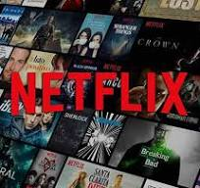
Introduction
Netflix has revolutionized the entertainment industry by providing an extensive collection of movies, TV shows, and original content. Its success is driven by a data-driven content strategy, which helps the platform identify trends, predict audience preferences, and make informed decisions about content acquisition and production.
In today’s competitive streaming market, Netflix continuously analyzes viewer engagement, genre performance, and content popularity to maximize user satisfaction and retention. By leveraging advanced data analytics and machine learning, Netflix ensures that the right content reaches the right audience at the right time.

Slide 3
Objective
The primary goal of this analysis is to understand Netflix’s content trends and optimize its content strategy using data-driven insights. The key objectives include:
Analyze Content Trends
Identify how Netflix’s content library has evolved over the years.
Identify Popular Genres
Determine which genres attract the most viewers and engagement.
Evaluate Audience Engagement
Study the relationship between vote count, ratings, and popularity.
Strategic Content Investment
Identify high-performing content and optimize future investments.
Predict Future Trends
Use past data to predict future content trends and audience behavior.

Slide 4
Scope
Content Performance Analysis
Analyzing the number of movie releases over time.
Genre-Wise Insights
Examining the most popular genres on Netflix.
Audience Engagement & Ratings
Evaluating the impact of vote count, ratings, and popularity.
Strategic Recommendations
Highlighting content gaps and opportunities for future investments.
Future Trends & AI Integration
Predicting emerging content trends in the streaming industry.

Slide 5
About the Dataset
The dataset used for this analysis contains key details about Netflix movies, including:
Movie Title – The name of the movie.
Release Date & Year – The year of release to track content trends.
Popularity Score – Measures how popular a movie is among users.
Vote Count & Vote Average – User engagement metrics based on ratings.
Genre – Categorization of movies based on type (e.g., Action, Drama).
Original Language – The language in which the movie was originally released.

Slide 6
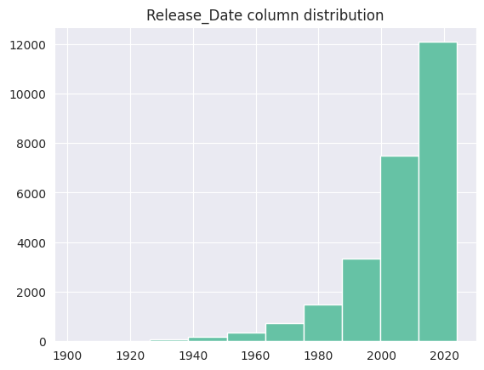
Netflix Content Release Trends
This Histogram represents the distribution of Netflix content based
on their release dates.
1️.Minimal Content Before 1980
2️.Gradual Growth in the 1980s-1990s
3️.Sharp Increase After 2000
4️ .Explosive Growth After 2015 –
5️ .Focus on Recent Releases –

Slide 7
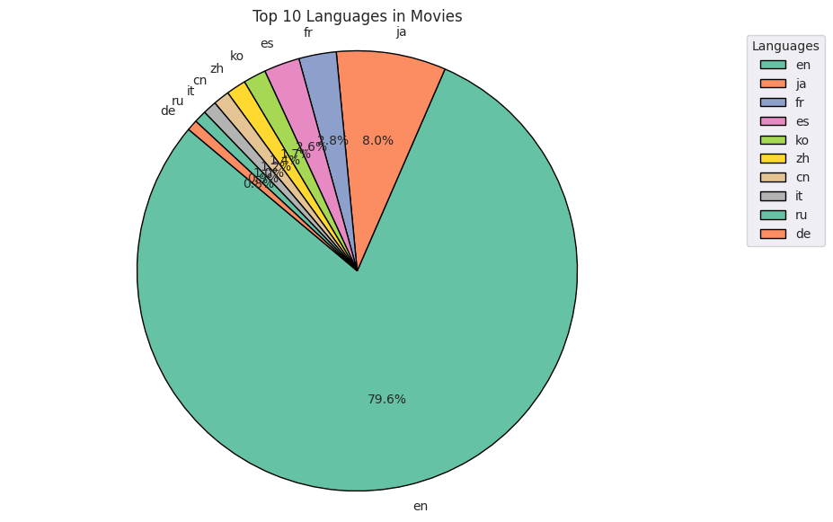
Language Distribution of Pie chart
1️.English Dominates (79.6%) – The majority of Netflix movies are in English, highlighting its global influence in content production.
2️.Japanese (8%) is the Second Most Common – Suggests strong representation of Japanese cinema, possibly due to anime and live-action films.
3️. French, Spanish, and Korean Hold Small Shares – These languages have a niche presence, aligning with Netflix's regional expansions.
4️.Diverse but Limited Non-English Content – Other languages like Chinese, Italian, Russian, and German contribute minimally, reflecting a market still focused on English-speaking audiences.
5️.Potential Growth in International Content – With Netflix's increasing investment in foreign-language productions, this distribution may shift in the future.

Slide 8
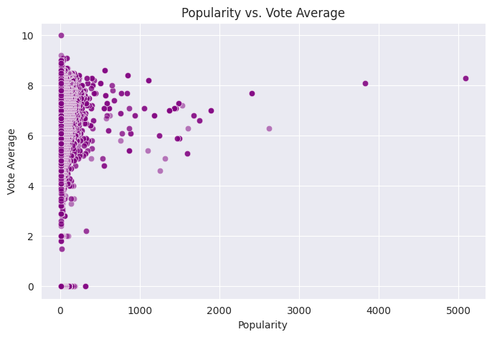
scatter plot showing the relationship between Popularity and Vote Average of movies.
No Strong Correlation – Popular movies don’t always have high ratings.
Dense Cluster at Low Popularity – Most movies have low popularity scores.
High-Rated Movies Exist Across Popularity – Some less popular films have high ratings.
Outliers with Extreme Popularity – Few movies have very high popularity scores.
Quality vs. Hype – Popularity doesn’t always mean higher ratings

Slide 9
Netflix Content Strategy Analysis – Key Insights
Q1: How has Netflix's content library grown over time? Netflix has significantly increased the number of movies in its library, especially in the 2010s and 2020s, reflecting its expansion strategy.
🔹 Q2: What are the most popular genres on Netflix? The top-performing genres include Drama, Comedy, and Action, while Thrillers and Documentaries have gained popularity in recent years.
🔹 Q3: How do audience ratings impact a movie’s popularity? Movies with higher vote counts and ratings generally have higher popularity, but some highly rated niche movies receive lower engagement, indicating a selective audience.
🔹 Q4: How does the release year and decade affect movie engagement? Movies from the 2010s and later receive higher engagement, while older movies (pre-2000s) tend to have lower visibility on the platform.
🔹 Q5: What role does language play in content popularity? While English-language movies dominate, non-English content—especially in Spanish, Korean, and Hindi—is experiencing growing demand.

Slide 10
Suggested Improvements for Netflix's Content Strategy Based on Analysi
1. Expand Genre Diversity
Invest in high-growth genres such as thrillers, documentaries, and sci-fi, which are gaining traction among viewers.
2. Boost International & Regional Content
Increase non-English content, as Spanish, Korean, and Hindi movies are showing significant demand.
3. Optimize Content Release Strategies
Strategically time content releases—such as releasing high-budget films during peak seasons like holidays and summer.
4. Improve Personalization & Recommendations
Enhance AI-driven recommendations to promote underperforming but highly rated movies.
5. Increase User Engagement through Exclusive Content
Produce more Netflix Originals in high-demand genres to retain subscribers.
Leverage collaborations with top creators and film industries globally to create exclusive, high-quality content.

Slide 11
Conclusions
The Netflix Content Strategy Analysis provides deep insights into the platform’s content trends, audience preferences, and engagement patterns. Through data-driven exploration, we identified key factors such as the most popular genres, language trends, rating distributions, and content growth over time.
The findings reveal that Netflix's success is driven by strategic investments in high-performing genres, increasing demand for regional and international content, and a growing shift toward data-driven content recommendations. By leveraging these insights, Netflix can further optimize its content acquisition and production strategy, ensuring maximum audience engagement and competitive advantage in the streaming industry.

